Slide 1
Dynamics of a biologically realistic neural network model
Bachelor Thesis Psychobiology
Jiri Brummer
Supervised by Fleur Zeldenrust
26-6-2015

Slide 2
Outline
Introduction
What is a balanced network
Previous studies
Methods
Implementation
Analysis
Results
Discussion

Slide 3
Introduction

Slide 4
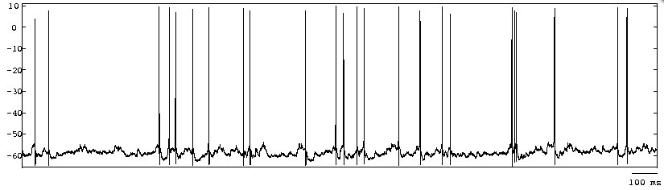
Background information
Cortical cells show irregular firing
Computational models
Balanced network
Can reach an Asynchronous Irregular state
Notes:
Ooit begonnen met onderzoek naar irregular firing dmv computational models, daarna computational neuroscience vakgebied an sich en daarmee ook de eigenschappen van een balanced network

Slide 5
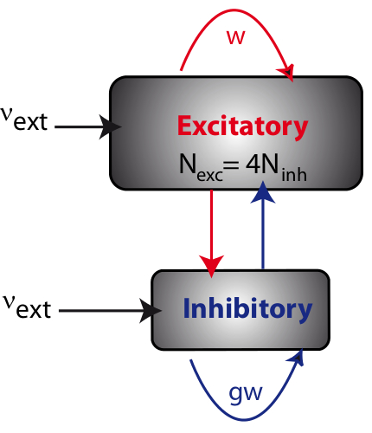
A Balanced Network
Randomly connected network
Balance between excitatory and inhibitory neurons
From www.yger.net

Slide 6
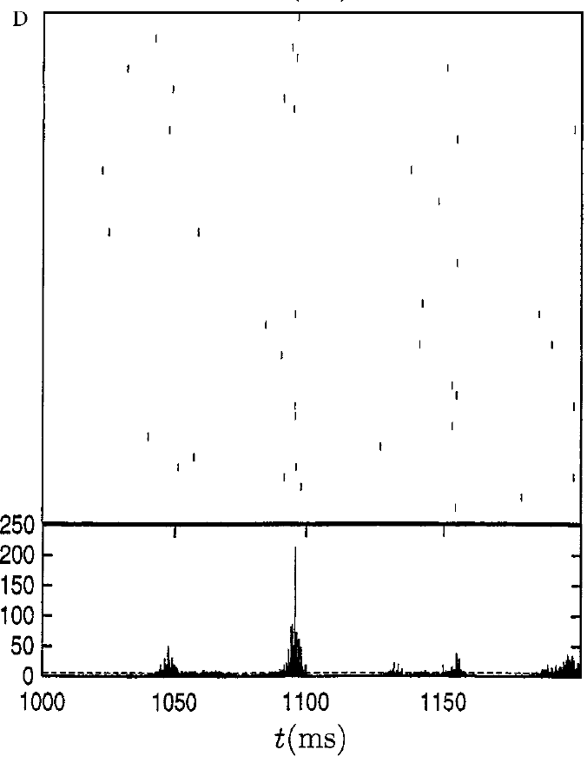
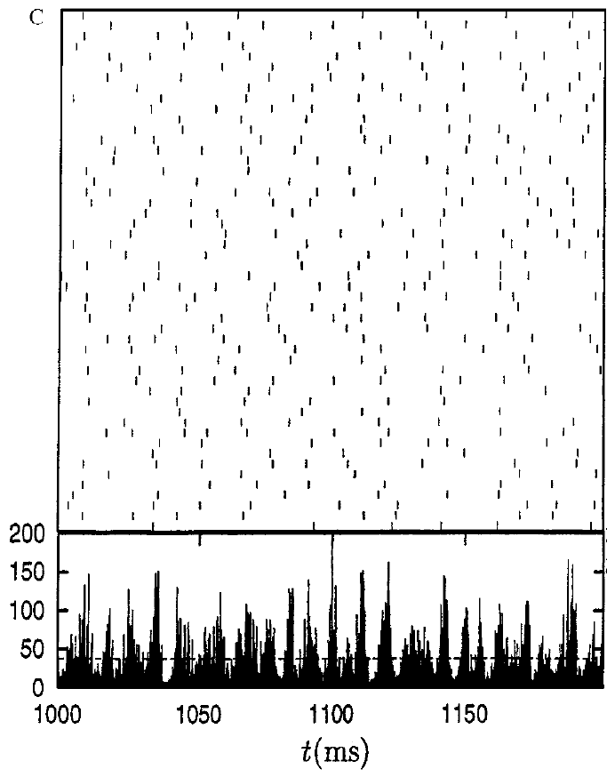
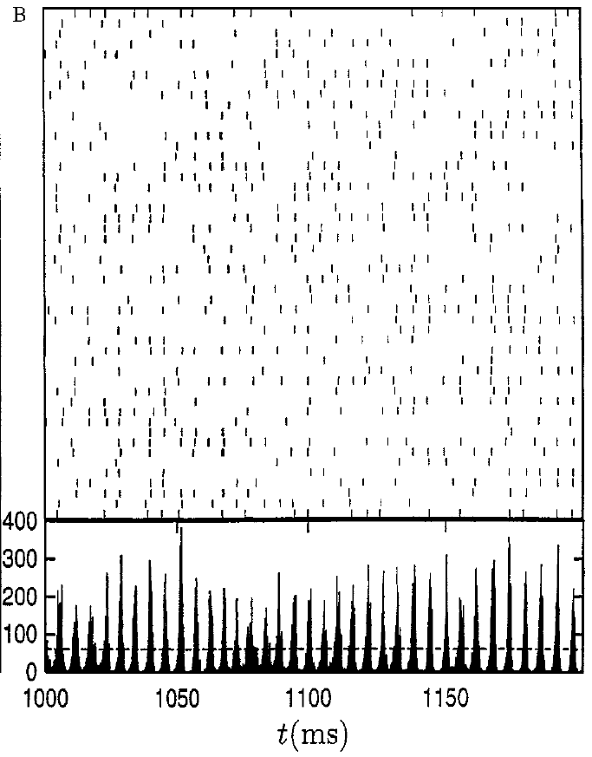
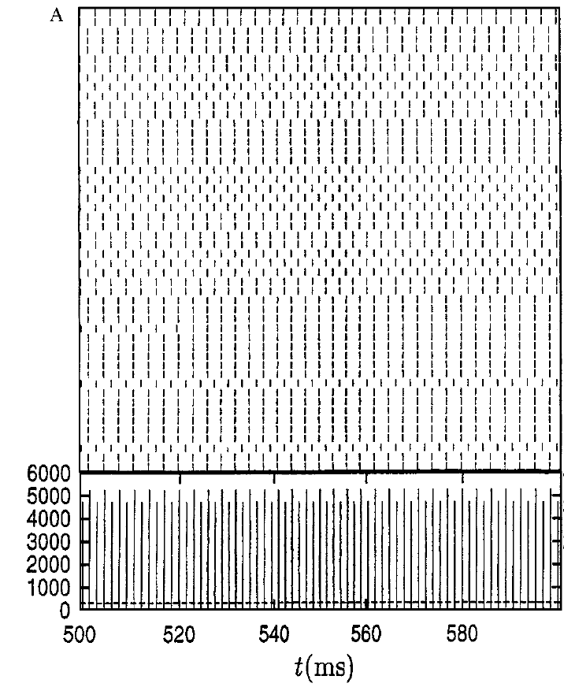
Balanced Network in different states
4 combinations (Brunel, 2000)
Synchronous Regular (SR)
Synchronous Irregular (SI)
Asynchronous Regular (AR)
Asynchronous Irregular (AI)
Based on 2 parameters
External input
Strength inhibitory synapses

Slide 7
Biologically realistic model
Brunel (2000) simplest model
Synapse updates membrane potential
Yger (2013) more biologically realistic synapse
after a spike, conductance decays over time
Reaches Asynchronous Irregular (AI) state
AI state similar to human cortical activity

Slide 8
Research question
Can a network model with more biologically realistic synapses reach the same states as the original network with respect to synchrony and regularity.

Slide 9
Methods

Slide 10
Implementation of balanced network
BRIAN 2 simulator (Python)
800 excitatory and 200 inhibitory neurons
Stochastic external input
Free parameters:
Conductance of external input
Relative weight inhibitory synapses (g)

Slide 11

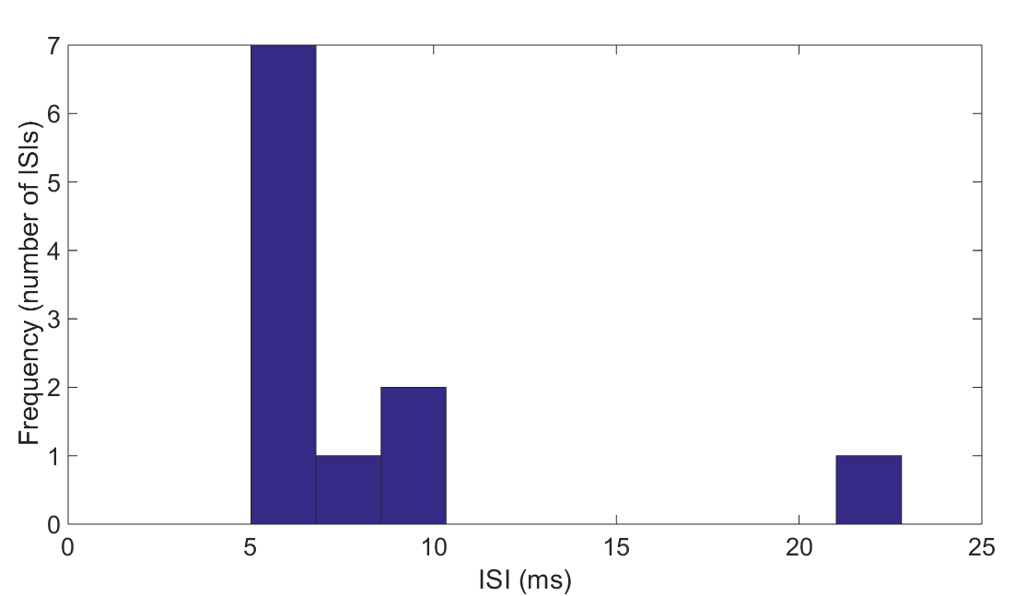
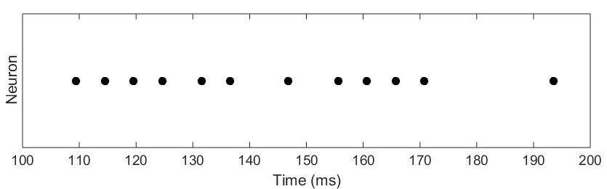
Quantification of Regularity and Synchrony
Objective measure Regularity
Coefficient of Variation (CV) of a neuron:
Distribution Inter-spike-Interval
CV of a network:
Average CV of neurons
Low CV regularity

Slide 12
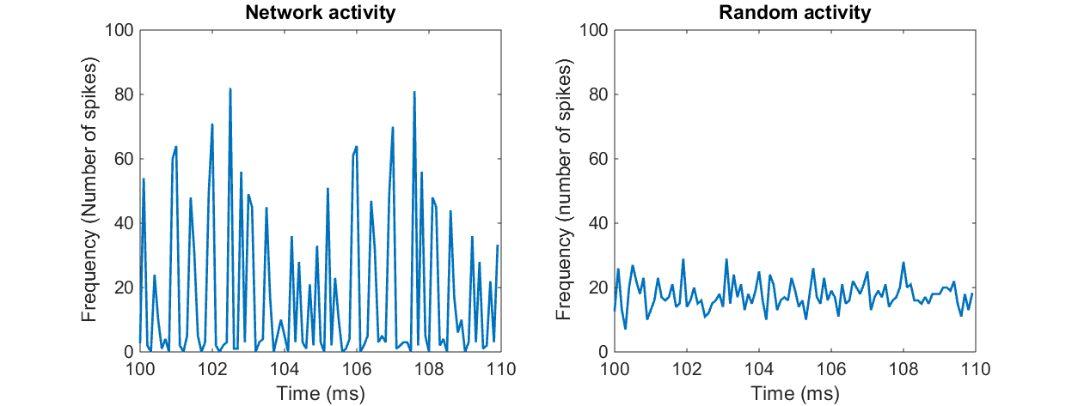
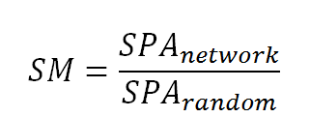
Quantification of Regularity and Synchrony
Objective measure Synchrony
Random activity
Synchrony Peak Average (SPA)
Average 3 highest peaks
Synchrony Measure (SM)
High SM, much synchrony

Slide 13
Clustering
Objectively cluster parameter sets in different states
K-means clustering

Slide 14
Results

Slide 15
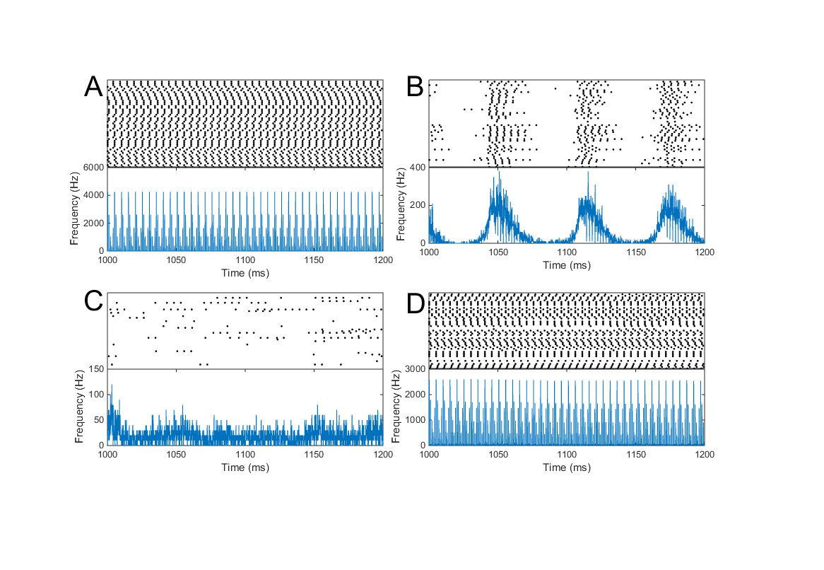
4 different states visible

Slide 16
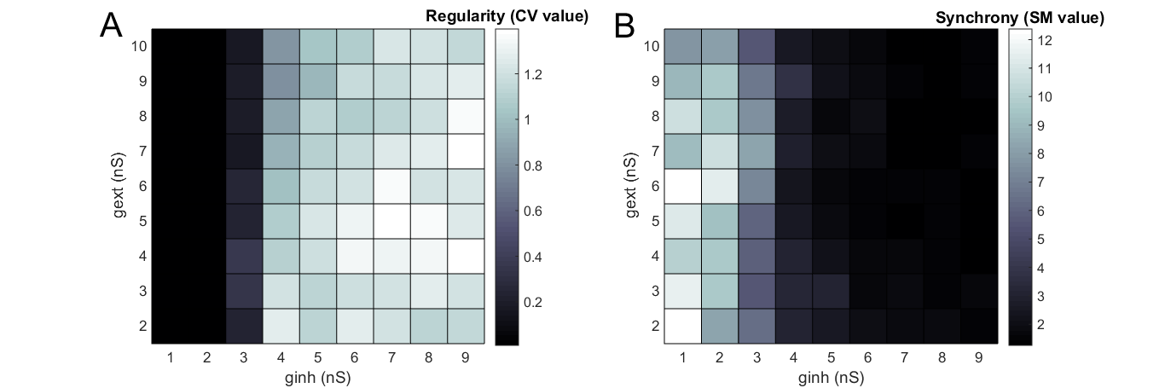
Quantification of Regularity

Slide 17
Quantification of Synchrony

Slide 18
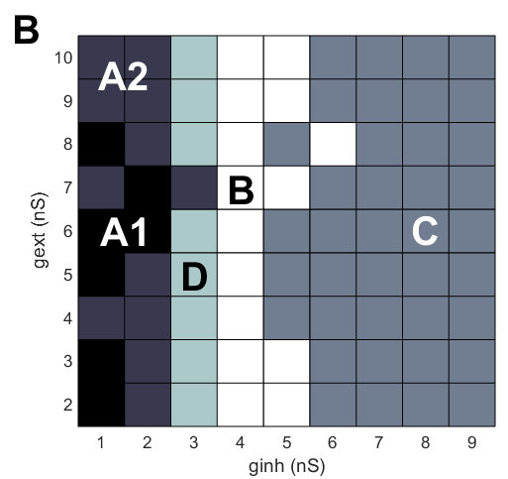
Clustering

Slide 19
4 different states visible

Slide 20
Discussion

Slide 21
Conclusion
The network model with more biologically realistic synapses can reach different balanced states with respect to Regularity and Synchrony, but the behavior differs from the simpler network model, as there is strong bursting behavior.

Slide 22
Possible explanations
The more biologically realistic synapse model
Decay keeps membrane potential to threshold: bursting
Time constant of inhibitory synapse higher
Synapse strengths distributed
Transition State
Scaling of network size

Slide 23
Why relevant?
Examine influence biologically relevant properties
Synaptic strength
Connectivity of brain area
Length of axons/ dendrites
Especially on Asynchronous Irregular State
Epilepsy
Extend with more biologically realistic components
Increase computational power

Slide 24
Take home
The model examined can simulate activity resembling human cortical activity.
Future studies can use this model, and extentions of it, to examine influence of biologically relevant properties
Therefore get more insight in computations underlying human cortical activity

Slide 25
Questions

Slide 26
Slides for possible questions

Slide 27
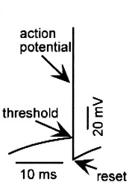
Leaky Integrate-and-Fire (LIF) neurons
Computational powerful
Easy to analyze
Very few parameters

Slide 28
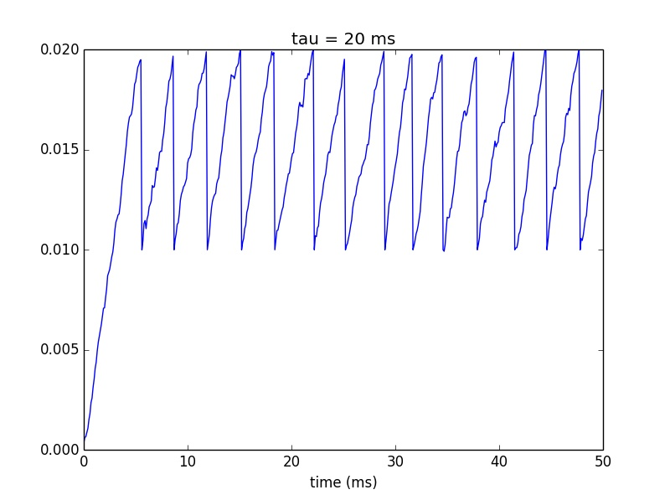
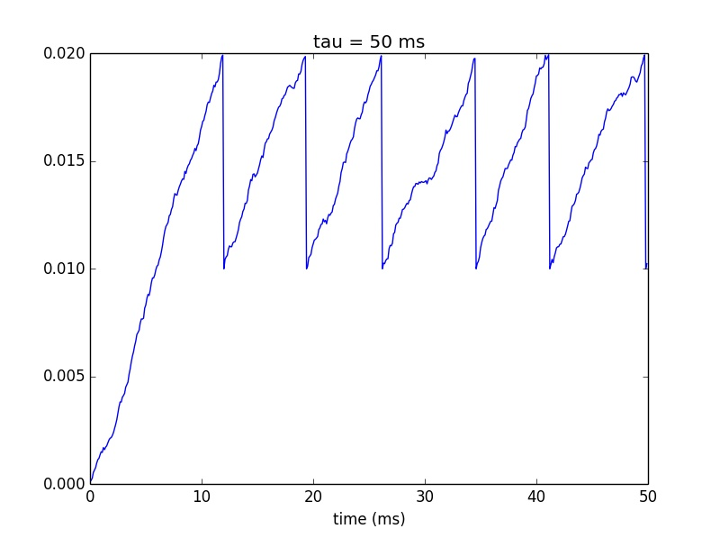
LIF neurons behavior
Example: influence of integration time (tau)

Slide 29
A Balanced Network
Recurrent network
Excitatory : inhibitory neurons = 4:1
w = synaptic strength excitatory connections
g = relative weight inhibitory connections
Vext = frequency external input
From www.yger.net

Slide 30
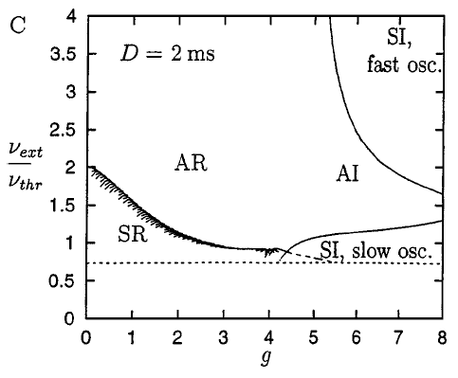
What causes different states?
Based on variations of 2 parameters:
External input (Vext)
Relative strength inhibitory synapse (g)

Slide 31
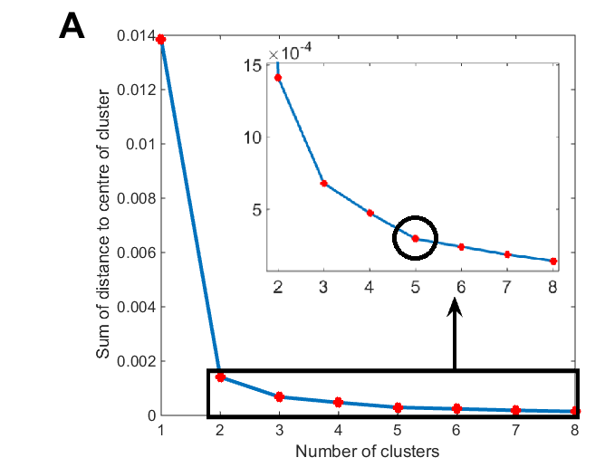
Clustering

